Slide 1
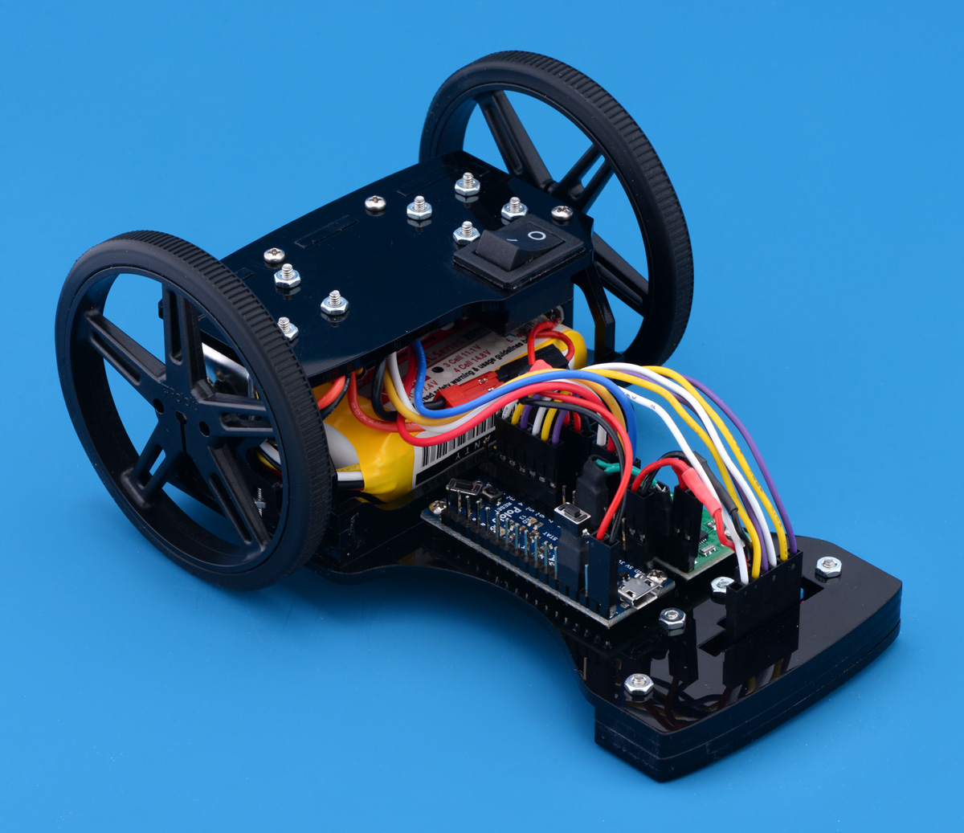


Team Name: 10 Minutes
Robot Name: TenX-Bot
Fast and ready to race

Slide 2
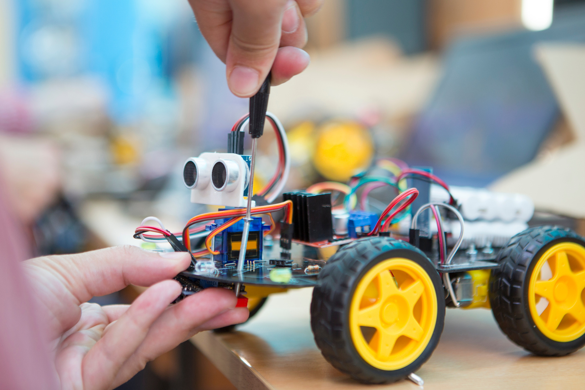

Our Build Philosophy
Focused on speed and stability with a compact design.
Prioritized a low center of gravity for better turns.
Chose lightweight materials to maximize acceleration.
We kept enough space to fit all components easily.

Slide 3

The Biggest Challenge
We had trouble fitting all the parts on the chassis.
It was hard to arrange the wires in the right place.
Faced frequent small circuit connection issues.
Soldered wires came off during movement or handling.
Code was not uploading to the Arduino Nano.

Slide 4



The Solution & What We Learned
The Solution :
Double-checked all connections before powering the circuit.
Applied proper soldering techniques for stronger joints.
Ensured correct port and board settings in Arduino IDE.

Slide 5

What We Learned
Checking each part early saves time later.
Importance of patience and attention to detail in electronics.
Good teamwork helps to solve problems quickly.
Learned the value of good soldering and circuit safety.
Realized that small errors can lead to major problems.

Slide 6


Slide 7


